Slide 1
FBA to BIP
Building School Capacity to Provide Behavior Support for Students With Persistent Challenging Behavior
Chris Borgmeier, PhD
Portland State University
Chris.Borgmeier@pdx.edu
www.BasicFBA.com @BasicFBA

Slide 2
Introductions
Who is here today?
  Special Education Teachers?
  Administrators?
  Paraprofessionals?
  District Behavior Specialists/BCBAs?
  Outside consultants?
  Responsible for conducting FBA and building BSPs?

Slide 3
Functional Behavioral Assessment (FBA)
An empirically supported practice that has been demonstrated to improve both the effectiveness & efficiency of behavioral interventions in schools
    (Blair, Umbreit, & Bos, 1999; Carr et al., 1999; Epstein, Atkins, Cullinan, Kutash, & Weaver, 2008; Ingram, Lewis-Palmer, & Sugai, 2005; Lee, Sugai, & Horner, 1999; Loman & Horner, 2014; Newcomer & Lewis, 2004, Strickland-Cohen & Horner, 2015; Strickland-Cohen, Vatland, Spear, & Romer, in prep)

Slide 4
FBA/BSP in Schools: How are we doing?
Growing body of research showing that FBS can be effectively designed and implemented by typical school personnel
    (Crone, Hawken, & Bergstrom, 2007; Dukes, Rosenberg, & Brady, 2007; Loman & Horner, 2014; Maag & Larson, 2004; Renshaw et al., 2008; Scott, Nelson, & Zabala, 2003; Strickland-Cohen & Horner, 2015)
However…
  FBA continues to be underutilized
  Schools continue to struggle to utilize FBA information to build and implement individualized supports
    (Blood & Neel, 2007; Cook et al., 2007, 2012; Scott & Kamps, 2007; Scott, Liaupsin, Nelson, & McIntyre, 2005; Van Acker, Boreson, Gable, & Potterton, 2005)
Notes:
Plans the lack critical features and that even worse contain contraindicated strategies

Slide 5
FBA/BIP → Typical Practice… How are we doing?
We often use our most effective tools only after challenging behaviors have become severe and/or dangerous (Scott et al., 2010)
  Driven by the Law, rather than used as a more proactive support
  Behavior Support needs to be implemented before teachers and staff members have reached the limits of their frustration
  → An extremely challenging entry point to support
Notes:
This is somewhat frustrating b/c if there is one thing that we know about problem behavior it is that it gets worse over time…

Slide 6
Why Does FBA Continue to Be Underutilized In Schools?
Common barriers…
  Lack of personnel with sufficient training in FBA/BSP can lead to providing support in a “triage” manner
      Behavior Specialist = Fire Fighter/Emergency Personnel
      Opportunity is lost to utilize FBA for less severe persistent problem behavior
  Plans built by “specialist” with minimal input from implementers
      Plans lacking contextual fit
      Lack of follow-up support, feedback, coaching

Slide 7
What is your District’s Investment?
Capacity for Behavior Support
Most Complex FBAs (1%)
One District example:
40,000 students
X .01 (1% of students)
4,000 students requiring Intensive Behavior Support
4,000 students/ 4 District Beh. Specialists =
400 students/ District Behavior Specialist
What’s your Math?
# of students in your district
X .01 (1% of students)
# students requiring Intensive Behavior Support
# of students/# of District Behavior Specialists

Slide 8
Overcoming Barriers: A Proactive Approach to Behavior Support Planning
Many of problem behaviors that teams encounter do not require comprehensive FBA-BSP
Using simplified FBA-BSP procedures that “match” the level and intensity of problem behavior
    Provide FBS at the first signs of persistent problem behavior
Basic FBA/BSP:
Non-Dangerous Behaviors and Maintaining Functions are Easily Defined and Identified
Complex FBA or Functional Analysis:
Behaviors and Maintaining Functions Vary, and are not Easily Defined and/or Identified
Notes:
8
Alternative that researchers have suggested , using Function based support proactively

Slide 9
Redefining the Role of the District Behavior Specialist
District Behavior Support Specialist
Facilitate District Leadership Team focusing on Systems of Tier 2 & Tier 3 Behavior Support
Train 3-4 people per school to conduct “Basic” FBA/BIP
Coach and Support Teams building behavior support plans from Assessment information
Support School Teams with Complex FBA/BIP cases

Slide 10
Basic Message:
Capacity Building
Any time you feel overwhelmed the answer is likely to include investing in the training of others.
As schools adopt Tier 2 and Tier 3 PBIS supports, the behavior specialists in the district are often overwhelmed with requests to conduct functional behavioral assessments and building behavior support plans.

Slide 11
The Basic FBA to BIP Training Series www.BasicFBA.com

Slide 12
Basic vs. Complex FBA/BSP
 | Basic | Complex
For: | Students with mild to moderate problem behaviors (behaviors that are NOT dangerous or occurring in many settings) | Students with moderate to severe behavioral problems; may be dangerous and/or occurring in many settings
What: | Relatively Simple and Efficient process for behavior support planning based on “practical” FBA data | Time-intensive process that involves emergency planning, family-centered planning, and collaboration with outside agencies
Developed by whom: | Team of school-based professionals (e.g., PBS team members whose job responsibilities include FBA and behavior support planning) | School-based team including professionals trained to develop and implement intensive interventions for students with severe problem behaviors (e.g., behavior specialist)
12
Notes:
12
Training school-based personnel will allow us to…
12

Slide 13


Empirical Support for Basic FBA to BIP
Loman & Horner (2014)
Strickland-Cohen & Horner (2015)
Pinkelman, & Horner (2017)
Borgmeier, Loman, Hara, & Rodriguez (2014)
Strickland-Cohen et al. (2016)

Slide 14
Training Modules: Big Ideas
Skills taught in manageable chunks
  60-90 minute modules
  Intended delivery: 1 module every 1-2 weeks
Interactive Training Activities – Learn through demonstration & practice application activities
Built-in Assessment Activities – included at end of each module
Homework Tasks with each module for real-world practice that culminate in implementation of a BSP developed from an FBA

Slide 15
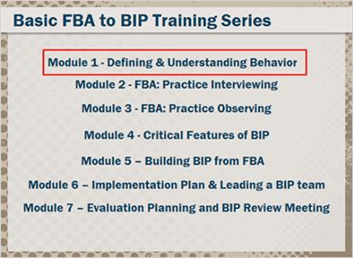
Basic FBA to BIP Training Series
New interactive on-line e-modules

Slide 16
Online Module Features
Pre and Post Assessment for Each Module
Participant Guide and Materials to Follow Along and Practice Using Forms/Tools
Interactive Activities with built in Checks for Understanding
Embedded video to model interviewing
Embedded video for practicing observations
Links to data collection and graphing resources specific to Basic FBA to BSP
Email follow-up with Homework Reminders
Free!

Slide 17
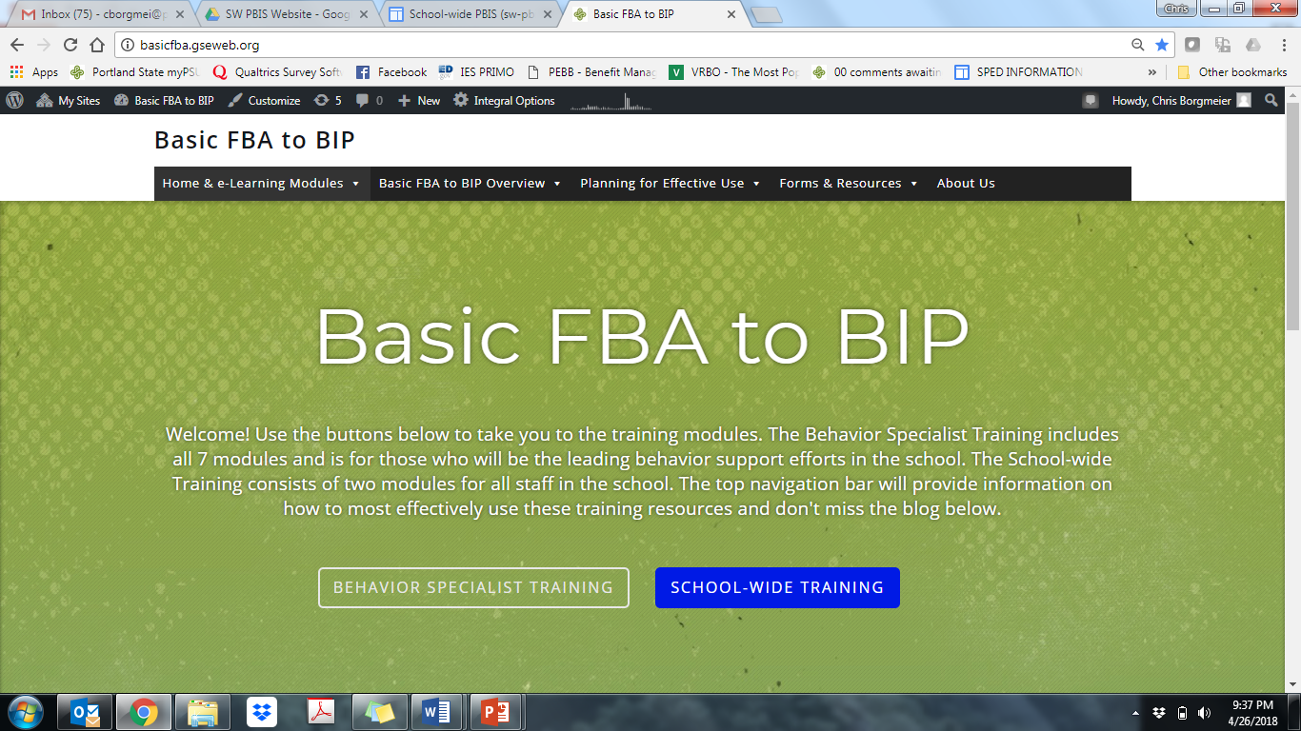
www.BasicFBA.com
Also available at http://moodle.tasnatbs.org

Slide 18



Basic FBA to BIP
e-Learning Modules
Eddie Croissant
Lead Instructional Designer
Tyler Collier
Web Developer

Slide 19
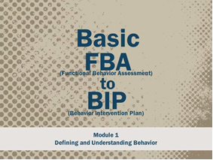

Slide 20
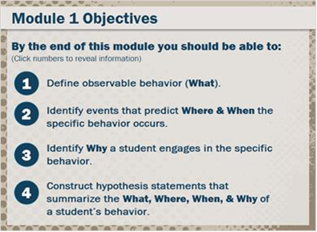

Slide 21
ABC Tracker
Teacher completes in Classroom

Slide 22
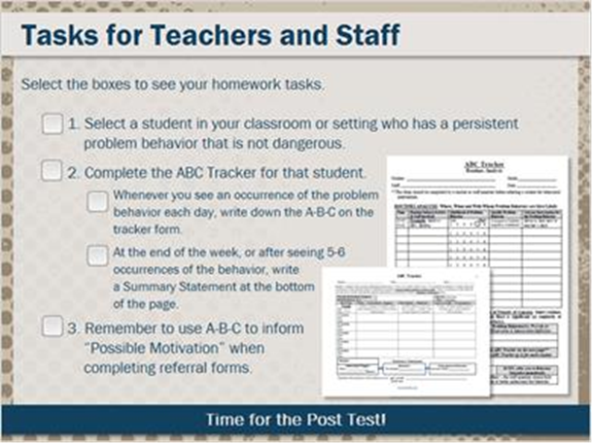

Slide 23
Module 2 – FBA Interviews
Step by Step Training w/ video model and practice activities

Slide 24
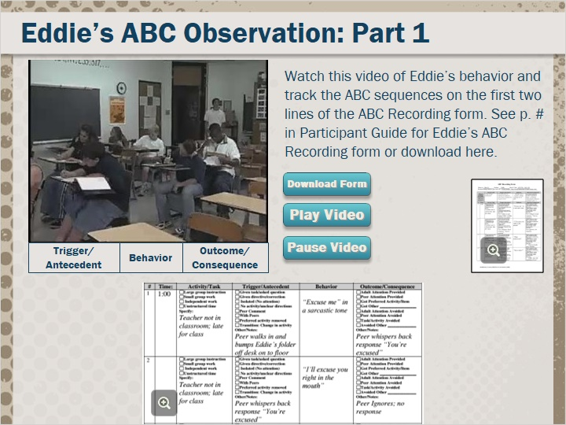
Module 3 – FBA Observations
Step by Step Training w/ video model and practice activities

Slide 25
Modules 4 & 5 –
Function–Based Intervention
Training to Identify Function-Based Interventions using information from the FBA
  Develop a Competing Behavior Pathway w/ a Replacement Behavior
  Identify interventions to Prevent, Teach, Reinforce & Correct Behavior
  Identify Successive Approximations to support the student to progress from the Replacement Behavior to the Desired Behavior

Slide 26
Module 4: Function-Based Intervention

Slide 27
Behavior Intervention Plan

Slide 28
Module 5: Behavior Intervention Strategies

Slide 31
Successive Approximations Worksheet

Slide 32
Homework Task: Complete the Behavior Intervention Plan form

Slide 33
Module 6 – Implementation Plan
Implementation Planning
  How to facilitate an Implementation Planning meeting
  Contextual Fit
  Supporting Implementation

Slide 34
Implementation Plan form

Slide 36
Basic FBA to BIP Table Tent

Slide 38
(Pinkelman & Horner, 2017)

Slide 39
Daily Point Card Template

Slide 41
Module 7 – Evaluation Plan & BIP Review Meeting

Slide 42
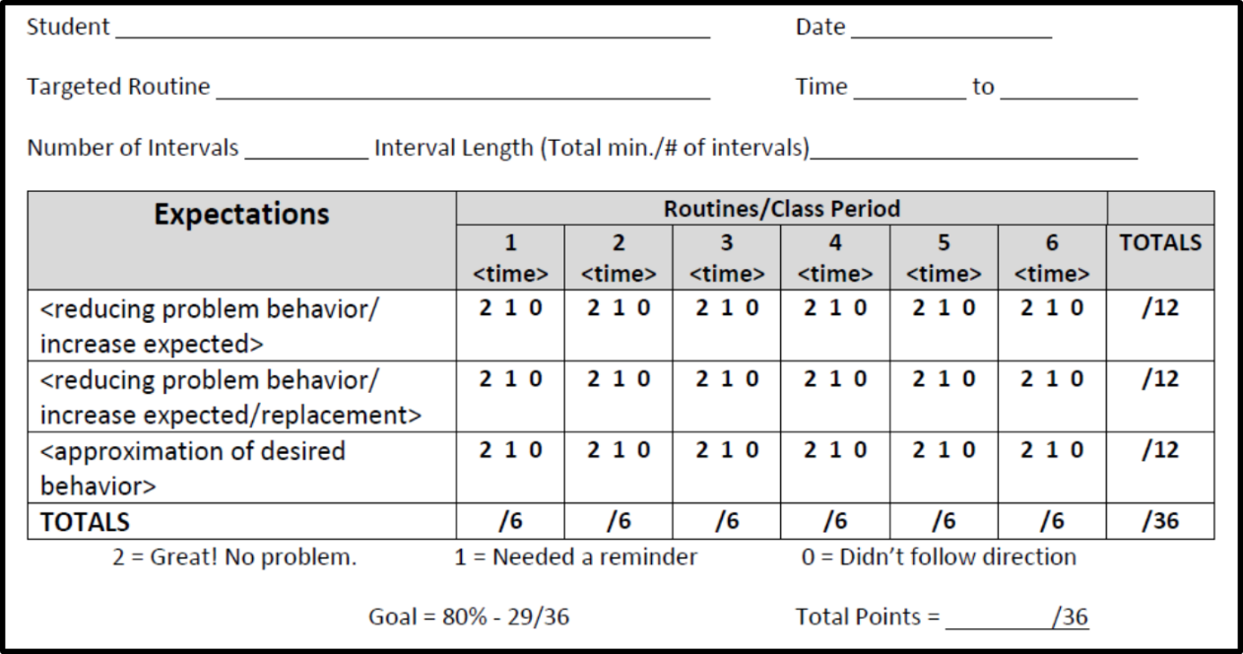
Daily Point Card w/ Implementation Checks
Research suggests Daily Self-Monitoring by the implementer is an effective and feasible strategy for supporting implementation & collecting implementation data to inform feedback
Front
Back

Slide 43
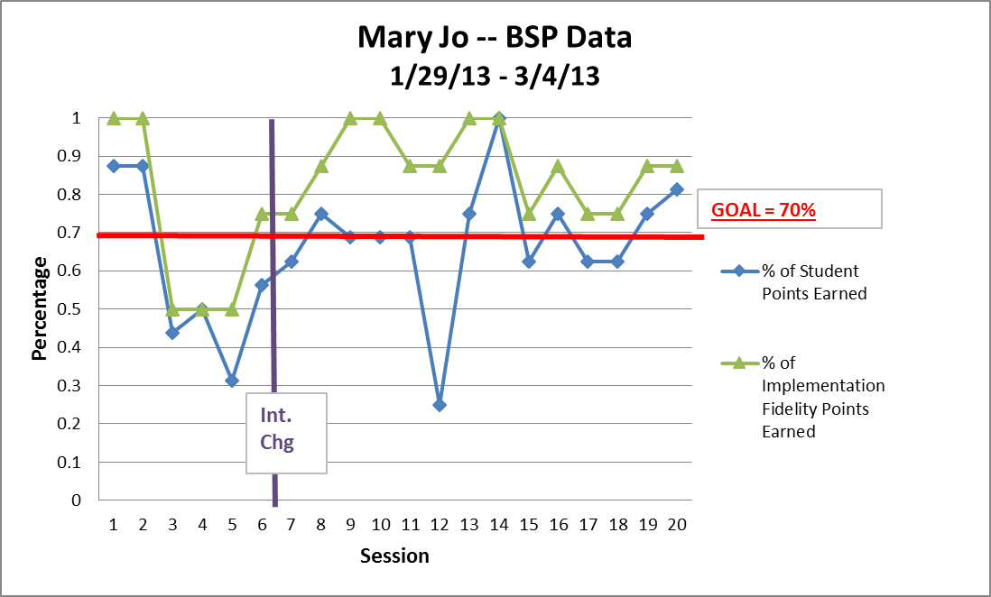
Data-Based Decision Making

Slide 44
Evaluation Plan

Slide 45
BIP Review Meeting Form

Slide 48
Users, Feedback & Data

Slide 49
Completers who filled out the Google Survey Evaluation
Behavior Specialist
  Mod 1 – 1128
  Mod 2 - 822
  Mod 3 – 553
  Mod 4 – 637
  Mod 5 – 613
  Mod 6 -- 426
  Mod 7 – 369
TASN Moodle Site
  Mod 1 – 576
  Mod 2 - 339
  Mod 3 – 257
  Mod 4 – 279
  Mod 5 – 200
  Mod 6 177
  Mod 7 – 159
School Wide Training
  Mod 1 – 1224
  Mod 4 - 823

Slide 50
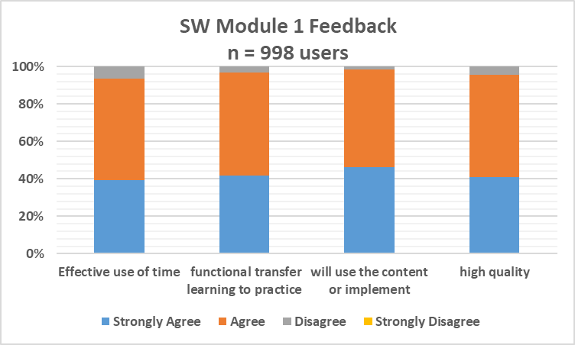
Basic FBA to BIP e-Learning Module 1 User Evaluation Data

Slide 51
How are School Districts & Schools using the Modules?

Slide 52
Behavior Specialist Training:
Module 2 (FBA Interviews)
Of the 255 respondents who completed the Behavior Specialist Training as required by professional development for their employer
  83% of respondents reported they were required to provide evidence of module completion
  47% of respondents identified that they were being required to complete the homework.
  75% reported that a coach was available to answer questions they had about the module or homework
  58% reported receiving feedback on homework tasks they completed

Slide 53
School-wide Training:
Module 1
Out of 990 Completers of the School-wide Training, who completed the module as part of their Professional Development at work:
  80% were required to provide evidence of module completion
  18% were required to complete and turn in the homework.
  57% identified that there was a coach available to answer questions they had about the module content or homework task
  29% reported the opportunity to receive feedback following completion of the homework task.

Slide 54
Basic FBA to BIP:
Planning to Maximize Implementation

Slide 55
Planning for Effective Use
School-wide Plan

Slide 56
Professional Development in Schools
Training efforts should result in both:
  Changes in educator behavior that lead to improved student outcomes
  Changes in organizational or systems-level practices
      (Reinke et al., 2014)
  It’s going to take more than training…

Slide 57
NOT JUST TRAINING → A Comprehensive Plan of Professional Development
During the training or modules – expert guidance and support to answer questions
Homework Completion with Feedback and Support is critical
Once is not Enough! -- Repeated Practice completing FBA/BIP is necessary to build Fluency & experience a range of examples
Who can provide this support?
  Need a District Plan for Ongoing Coaching & Technical Support

Slide 58
A Comprehensive PD Plan
Commitment: Tier 3 Behavior Support is more than Practices, it’s a Commitment to supporting students with the most significant behavioral needs that is grounded in Equity
Administrator Buy-in, Commitment and Participation are Essential at the School and District Levels
District Plan for Coaching Support from Behavior Specialists

Slide 59
Planning to Maximize Basic FBA to BIP
Establishing the District Context
STEP 1: Establish a District Level Leadership Team focusing on Systems of Tier 2 & Tier 3 Behavior Support
STEP 2: Evaluate your current capacity and personnel to implement Tier 3 Behavior Support
STEP 3: Develop a 3 year Action Plan & PD Plan for Implementing Function-Based Support

Slide 60
Planning to Maximize Basic FBA to BIP
Establishing the District Context
STEP 4: District-level Behavior Specialist with FTE dedicated to building school capacity & Redefining Job Description
STEP 5: Develop Skills and Experience of District Behavior Specialists with Basic FBA to BIP training and processes
STEP 6: Identify School Teams and Plan for PD that includes Basic FBA to BIP training and ongoing coaching support

Slide 61
District Behavior Support Specialist
Facilitate District Leadership Team focusing on Systems of Tier 2 & Tier 3 Behavior Support
Train 3-4 people per school to conduct “Basic” FBA/BIP
Coach and Support Teams building behavior support plans from Assessment information
Support School Teams with Complex FBA/BIP cases

Slide 63
Increasing Capacity in Schools
School-Level Behavior Specialists
  Train at least 3-4 personnel with flexibility in their schedule to conduct basic FBA/BIP
    Only train people who will have the capacity to carry out the responsibilities of FBA/BIP
    Make the administrator participates in training
Staff-wide Training (create a common language)
  All staff are trained in Basics of Understanding Behavior and Function-based Intervention
    Modules 1 & 4 (now available online)

Slide 64
Basic FBA to BIP
Coaching Checklist
District Behavior Specialist Providing Feedback
Review Basic FBA to BIP documents for each module & provide feedback to develop skills of School-Level Behavior Specialists

Slide 65
Thank You!
All Basic FBA to BIP materials can be found at:
www.BasicFBA.com
For more information please email:
chris.borgmeier@pdx.edu
@BasicFBA

Slide 66
Basic FBA to BIP School-wide Training

Slide 67
Doing the smallest things that make the biggest impact… for students with persistent challenging behavior
Supporting Students with Persistent Challenging Behavior requires applying Function-Based Intervention across all 3 Tiers
  Tier 1 – Basic training in function-based thinking & intervention….. & reviewing school-wide policies & practices
  Tier 2 – Using function to match students to intervention
  Tier 3 – FBA/BIP - Matching intervention to individualized student needs

Slide 68
A Continuum of Function-Based Assessment & Intervention
Complex FBA or Functional Analysis
Expanding our use of function-based intervention across tiers
Basic FBA/BSP:
Tier 2: Preliminary FBA to Match Intervention:
Function Friendly Classroom & School
ABC Tracker & Teacher Plan
Function-Based Thinking
Notes:
68
Alternative that researchers have suggested , using Function based support proactively

Slide 69
What is a Function-Friendly School?
“Have you ever seen….”
“Lantana, you skipped 2 school days, so we’re going to suspend you for 2 more.”
“Phoebe, I’m taking your book away because you obviously aren’t ready to learn.”
“You want my attention?! I’ll show you attention,…let’s take a walk down to the office & have a little chat with the Principal.”
What’s the problem with each of these responses to student behavior?

Slide 70
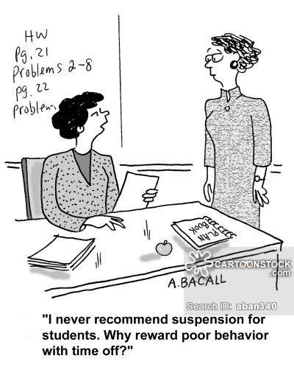
What is a Function-Friendly School?

Slide 71
What is a Function-Friendly Classroom?
Complex FBA or Functional Analysis
Setting up classroom focused on:
  Positive, predictable classroom
  Function-Based Thinking & Intervention
  limit consequences reinforcing problem behavior
  Class-wide self-advocacy training (e.g. how to ask for help, a break, an alt. task)
Basic FBA/BSP:
Tier 2: Preliminary FBA to Match Intervention:
Function Friendly Classroom & School
ABC Tracker & Teacher Plan
Function-Based Thinking
Notes:
71
Alternative that researchers have suggested , using Function based support proactively

Slide 72
Establishing a Social Culture
for Supporting Students w/ Challenging Behavior
Common Language
Function-Based Thinking
Antecedent/Trigger
Behavior (observable definitions)
Consequence
Function/ Possible Motivation
Setting Event
Replacement Behavior
Common Language
MEMBERSHIP
Common Experience
Common Vision/Values
Notes:
72

Slide 73
Benefits of Common Training in Understanding the Basics of Behavior & Behavioral Intervention
Staff have more tools to understand behavior & implement effective interventions in their classroom prior to referral
Staff can collect data prior to intervention on function of behavior
Staff can more effectively complete discipline referral forms
Increase efficiency & accuracy of FBA interviews with staff
Increased understanding of behavioral interventions (increase buy-in to plan & reduce resistance)

Slide 74
Function-Based Thinking
…..On the Fly Application
I’ve seen this behavior 4 times in the last week… let me think about this for a moment:
  Can I identify any patterns in the triggers and consequences for the problem behavior? A→B→C
  What do I think is the Function of Behavior?
  Should I collect more data? – the ABC Tracker?
  What are implications for how I should be responding?... Or providing support?

